Slide 1
Loan Repayment Prediction
Sabrina Yang

Slide 2
01
Introduction

Slide 3
Loan Repayment Prediction
01
Goal
02
Client
03
Focus
04
Target
Predict whether a borrower will repay their loan
Lending institution receives the principal + interest = PROFIT!
Only invest on the loan is most likely to pay back
Loan Status
Charged Off Fully Paid
Notes:
Bank – rather NOT to give out the loan to ppl who cant pay back because it’s possible to loss the principal
Instead of making interest by risking of losing principal , we want to focus on ONLY give loan to ppl LIKLEY to pay back -> emphasize on Recall -> Fbeta 2 score

Slide 4

Data Source
Kaggle.com
2.9M Datapoints
140+ Features
13 Years of Data
246K Datapoints
28 Features
3 Years of Data
Notes:
2018 -2020
financial cirsis data

Slide 5
02
Approach
Classification

Slide 6
EDA
79%
21%
Predict whether a loan status will be Charged Off or Fully Paid
Fully Paid
Charged Off
Notes:
Charged Off -> Postitve cases
Class imbalance : 1 to 4

Slide 7
Data Features
Borrower Characteristics
Employment Length
Address State
Home Ownership
Loan Traits
Loan Amount
Loan Purpose
Interest Rate
Installments
Terms
Financial Background
Annual Income
Debt to Income Ratio
Ratings and Scores
FICO Score
Lending Club Loan Grade

Slide 8
Data Features
Borrower Characteristics
Employment Length
Address State
Home Ownership
Loan Traits
Loan Amount
Loan Purpose
Interest Rate
Installments
Terms
Financial Background
Annual Income (log)
Debt to Income Ratio
Ratings and Scores
FICO Score
Lending Club Loan Grade
Notes:
take out Financial Pro features – see how my model do
Log on income

Slide 9
Models Baseline Comparison (F2)
0.20 -> Class Imbalance Fixed ->
0.526
Logistic Regression
KNN
0.199
Random Forest
0.429
XGBoost
0.578

Slide 10
03
Results
You could enter a subtitle
here if you need it

Slide 11
Random Forest

Slide 12
RF 1 - Confusion Matrix
F2 score : 0.4295
6,956
Fully Paid
32,138
Actual
5,654
4,453
Charged Off
Fully Paid
Charged Off
Predict

Slide 13
RF 4 - Confusion Matrix
F2 score : 0.5323
13,391
Fully Paid
25,703
Actual
3,694
6,413
Charged Off
Fully Paid
Charged Off
Predict
Notes:
More balance on diagonal score
Min_sample_leaf = 50 to 100

Slide 14
RF 6 - Confusion Matrix
F2 score : 0.5325
13,641
Fully Paid
25,453
Actual
3,662
6,445
Charged Off
Fully Paid
Charged Off
Predict
Notes:
But didn’t go up much -> slightly better than LogReg 0.526
Max_features [auto, sqrt, log2]
Log2 the best -> 28 features take log2 = 4.8 -> 5
Barely go up much

Slide 15
XGBoost

Slide 16
XGB 1 - Confusion Matrix
F2 score : 0.578
16,830
Fully Paid
22,264
Actual
2,613
7,494
Charged Off
Fully Paid
Charged Off
Predict
Notes:
Different from Random Forest
scale_pos_weight = 5
The class imbalance for original dataset is 0.79 (negative) vs 0.20(positive), so the most accurate scale_pos_weight should be around 4, but GridSearchCV shows me 5 worked out well so I choose 5 to continue my tunning. The reason I didn't choose anything above 6 (even their F2 score were higher) is because I don't want my classes got too many positive samples versus negative cases, and I assume the ideal ratio should be balance like 1: 1.

Slide 17
XGB 4 - Confusion Matrix
F2 score : 0.585
17,981
Fully Paid
21,113
Actual
2,358
7,749
Charged Off
Fully Paid
Charged Off
Predict
Notes:
N_estimator INCREase to 300
Scale_pos_weight=5
Learning_rate=0.05
Min_child_weight = 57
Max_depth =5

Slide 18
XGB 5 - Confusion Matrix
F2 score : 0.589
18,057
Fully Paid
21,037
Actual
2,289
7,818
Charged Off
Fully Paid
Charged Off
Predict
Notes:
Subsample =0.5
N_estimator INCREase to 300
Scale_pos_weight=5
Learning_rate=0.05
Min_child_weight = 57
Max_depth =5

Slide 19
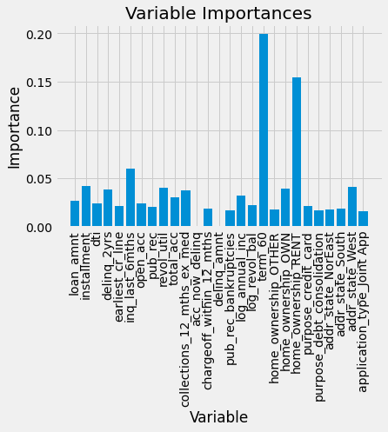
Feature Importance
Term
60 mons > 30 mons
Home ownership : RENT > OWN
Inquiry in last 6 months
Installment
State: West > South > North East

Slide 20
XGB with Fin Pro - Confusion Matrix
F2 score : 0.915
2,138
Fully Paid
36,956
Actual
561
9,546
Charged Off
Fully Paid
Charged Off
Predict
Notes:
TP , TN are up
FP , FN drops a lot

Slide 21
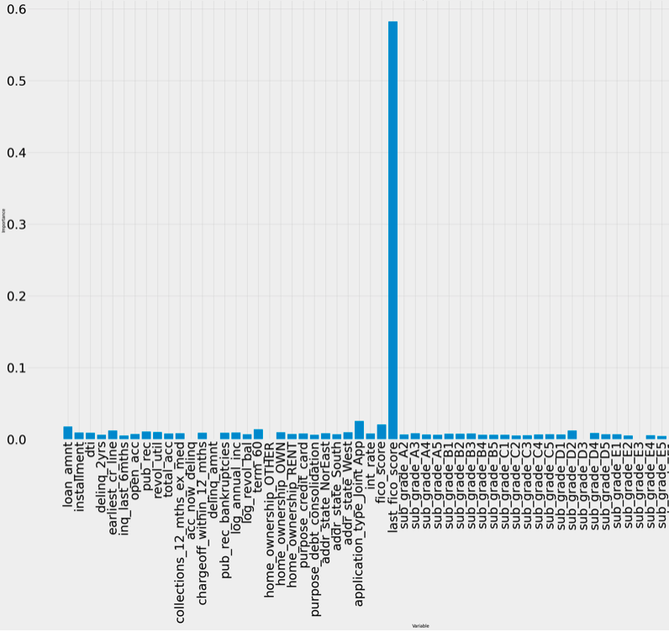
Feature Importance
Last FICO score
23 x important!
Application Type: Joint > Individual
Sub grade: D2
Difference from our last model
Term
Home Ownership: OWN > RENT
Notes:
Last FICO score : 0.58
Application type: Joint > Individual
Subgrade D2 : the break line
Fico score : 0.02 – loan amount –
Different from our coef importance
1. term 60 ( #5) – 0.014
2.home_ownership_OWN > RENT

Slide 22
Classification Suggestion
Last FICO score (high)
Loan Amount
Term (36m)
Application Type (Individual)
Good borrower!
Notes:
Client Bank –
Sweet Spot

Slide 23
Future Work
Tune on XGBoost more (computationally expensive)
early_stopping_rounds
colsample_by_tree
compare my improved model with Fin PRO features
Included more data points
keep null vales for Random Forest/ XGBoost
Size matters - parameters will be different too
Notes:
1000 -> 10k -> 100 k , parameters are different

Slide 24
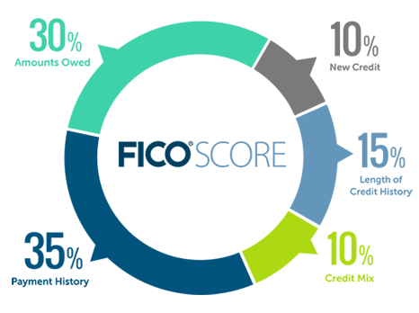
Thanks!
Notes:
And here’s how to keep your FICO score

Slide 25
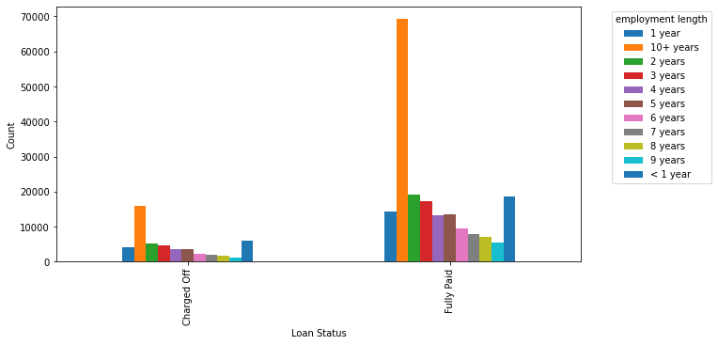
Employment Length
Borrower Characteristics
Loan Traits
Financial Background
Ratings andScores

Slide 26
Appendix
Tools:
Sklearn – LogisticRegression
RandomForestClassifier
GridSearchCV
Fbeta_score
Confusion_matrix
Classification_report
Xgboost - XGBClassifier
Numpy
Pandas

